Slide 1
Improving Robustness against label noise in semi-supervised models by applying self-supervision
By Group 2
Abhigyan, Mann, Aman

Slide 2
Problem Statement
What is label noise ? :
These are Observed labels that are classified incorrectly.
The labelled data provided to models is usually done by human annotators working on unlabelled data.
Thus, label noise is taken into factor as the annotation/classification errors in the labelled training data provided to a model.

Slide 3
Label noise in Semi-supervised Methods:
A majority of SSL methods rely heavily on treating high confidence predictions as pseudo-labels. These methods also introduce a separate model generated label noise
When such methods are applied on data with existing label noise, the accuracy of the model drops drastically as the the label noise in the data increases exponentially with every epoch.

Slide 4
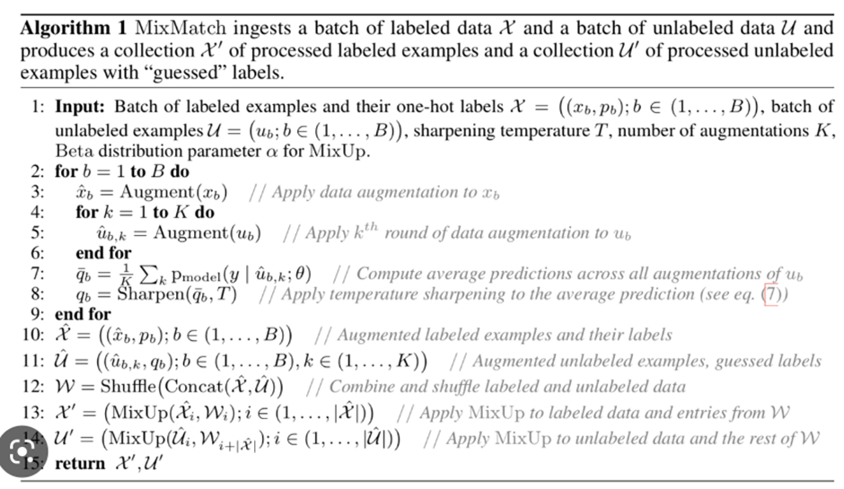
Paper Implemented : MixMatch
MixMatch is a popular SSL method It involves shuffling of the augmented labelled set with augmented unlabelled examples with their guessed labels and passing it through the same model with the original labelled and unlabelled set separately.
Though we have chosen MixMatch because of its easy implementation, our approach can easily be extended to other popular SSL methods

Slide 5
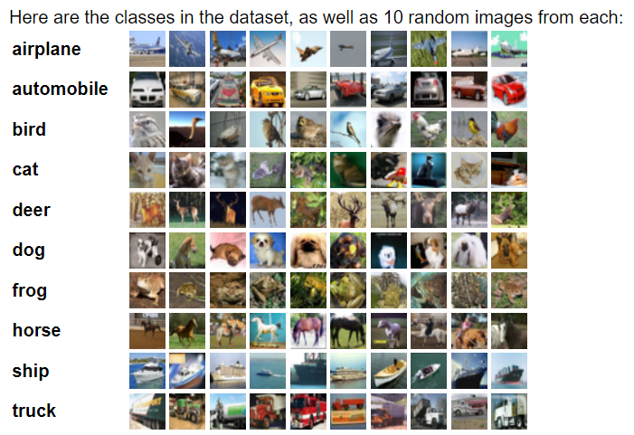
Dataset Used : Cifar-10
The CIFAR-10 dataset consists of 60000 32x32 colour images in 10 classes, with 6000 images per class.
There are 50000 training images and 10000 test images.
The test batch contains exactly 1000 randomly-selected images from each class.

Slide 6
Method
In our approach, we will be using Self-supervised learning techniques (SimCLR) to improve robustness against label noise in semi supervised framework (Mixmatch).
There is study that shows self-supervision improving robustness against label noise. [SSR: An Efficient and Robust Framework for Learning with Unknown Label Noise].
We start with a pretrained Resnet as our base model with two separate projection heads ( one for Self supervised training and one for semi-supervised training )
For each epoch, we will first perform self-supervised training on the labelled and unlabelled training data and then pass it through the Mixmatch function for semi-supervised training.

Slide 7
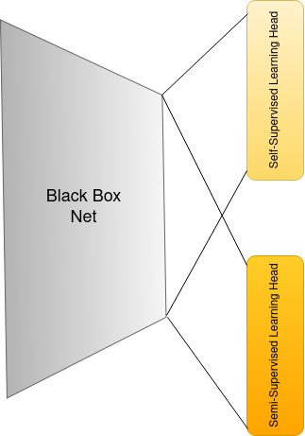
Efficiency with Meta-learning
We can parallelize the self-supervised and semi-supervised training in each epoch by giving a meta-learning architecture to our model.
As shown in the figure, this model architecture has a semi-supervised branch and a self-supervised branch.
With this we can train with both techniques in a single go. The loss used in backpropagation will be a combined linear loss.
L_{total} = L_{semi-supervised} + λ*L_{self-supervised}

Slide 8
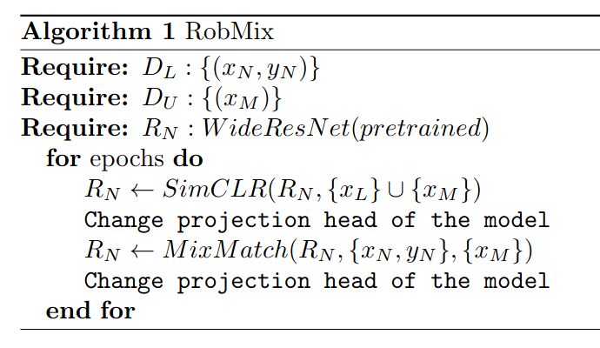
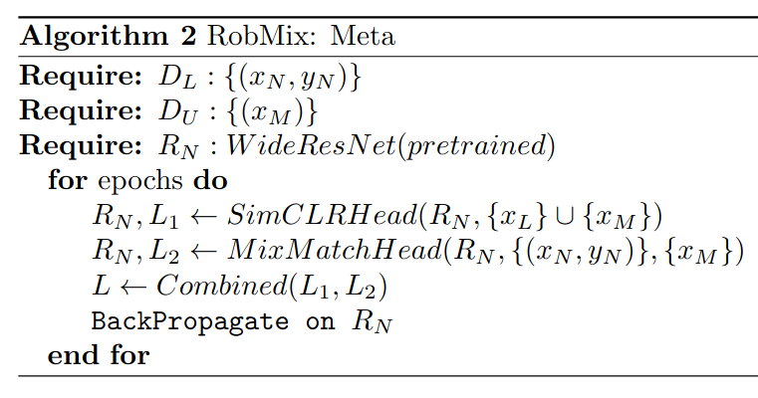
Pseudocode
2) Pseudocode with meta-learning architecture
Basic Pseudocode

Slide 9
Review of similar Approaches
S4L (Self-Supervised Semi-Supervised Learning) :
The paper aims at improving SSL model performances by pretraining the model using self supervision techniques (S4L Rotation and S4L Exemplar).
Key differences:
Self supervision techniques are used only for pre-training, while we use it in every epoch of our training
Our paper is specifically focused on improving robustness against label noise while S4L paper focused on improving model performance

Slide 10
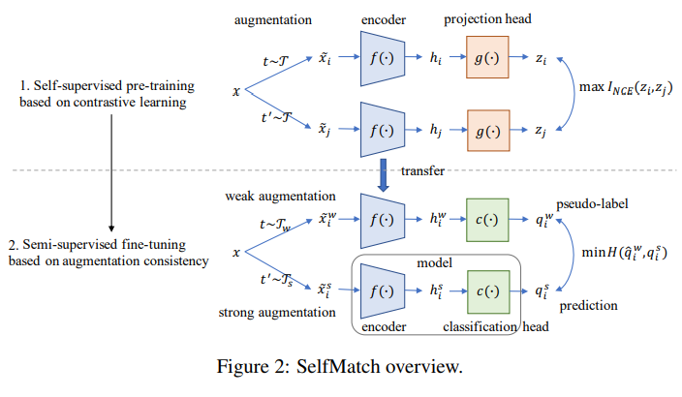
b) Self-Match
The goal of this paper is to combine self-supervision and consistency for semi-supervised learning. This is done by pretraining the model on contrastive learning and then performing semi-supervised fine-tuning based on augmentation consistency.
Key Differences
The approach uses self-supervised techniques for both pre-training and fine-tuning for semi-supervised data

Slide 11
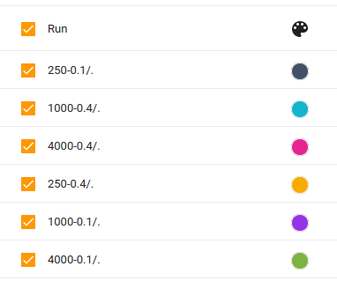
Reproduced Results
To demonstrate the effect of label noise on the results, we made 7 different copies of our dataset, each with different number of labels and label noise as shown in the figure.
Eg: 250-0.1/. : 250 labels with 0.1% label noise

Slide 12
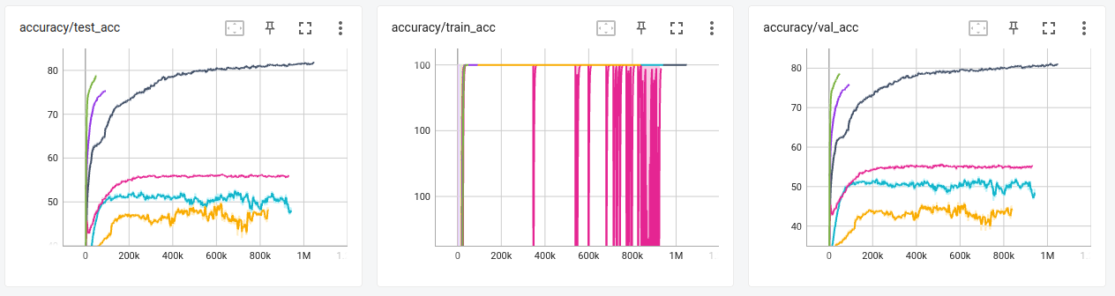
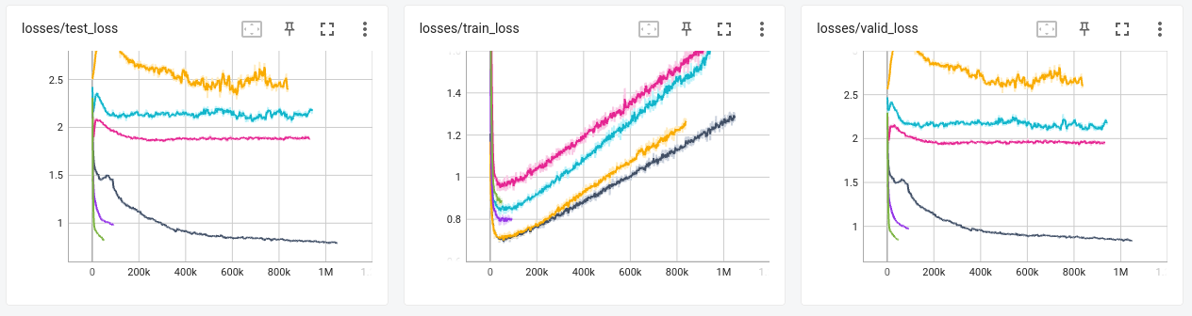

Slide 13
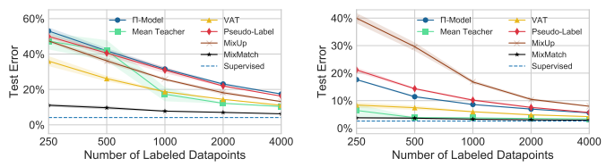

Actual results
The original results were obtained on SVHN and SVHN+extra datasets
No label noise was added to the datasets
Most of the comparisons done in the original paper are with other SSL models on the same dataset.

Slide 14
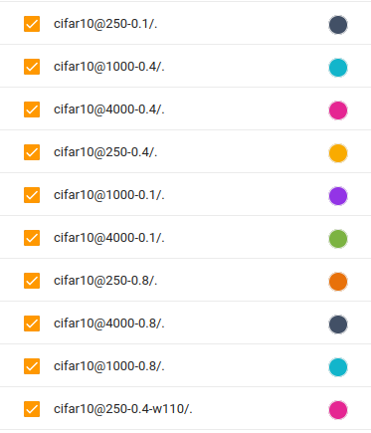
Experiments & Results
A) Noisy Labels
The following are results after running the model with varied levels of artificially induced label noise on datasets with 250, 1000 and 4000 labels:

Slide 15
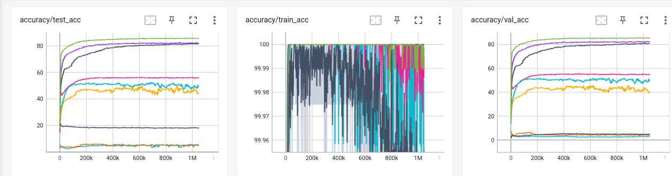
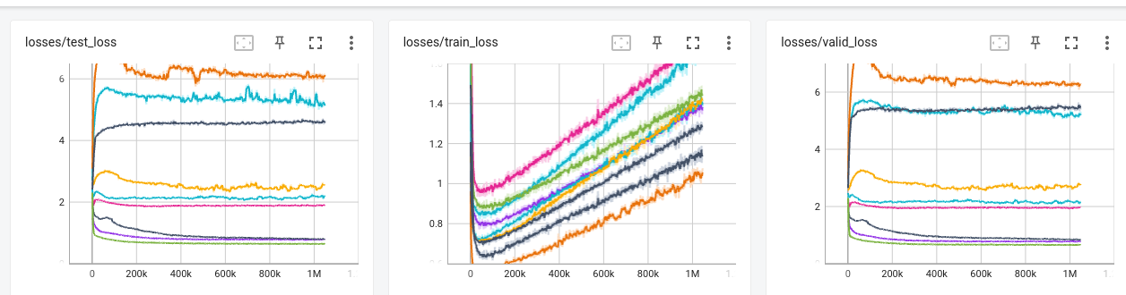

Slide 16
As expected, label noise plays a direct role on model performance. Model gives best performance with 10\% label noise and 4000 labels.
Label noise is directly related to the number of labels in the data. This makes sense as more labels more options for misclassification, hence a more varied label noise.

Slide 17
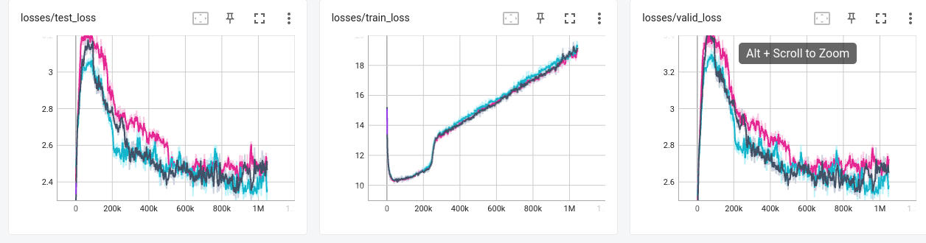
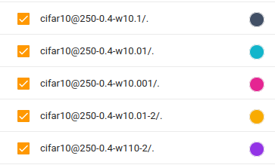
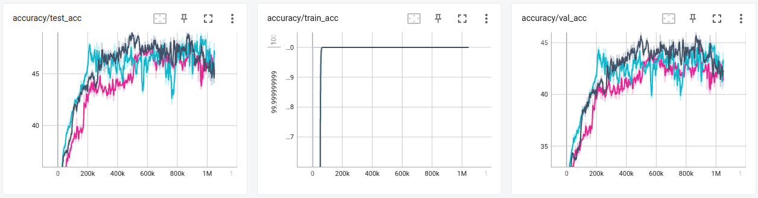
B) No gradient update in Self-supervised branch
For this experiment, we stop the updation of weights (gradient = 0) in the self-supervised projection head.

Slide 18
As we can see, even after stopping updation of weights in the self-supervised projection heads, the loss and accuracy graphs keep up the general trend, thus indicating that the model continues to learn, though there is a drop in overall model performance as observed.
RobMix gives the best performance with when the weights offered to L_{semi-supervised} and L_{self-supervised} are at a difference of 10 ( ٖ λ = 0.1)

Slide 19
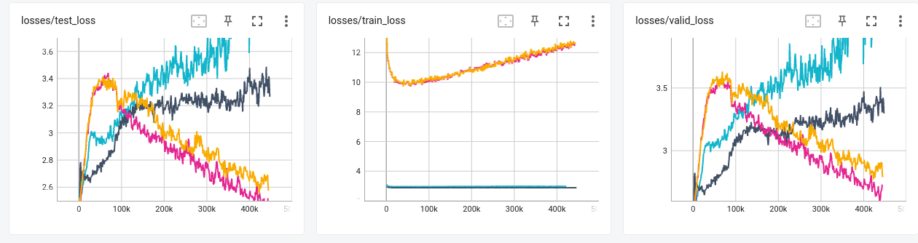
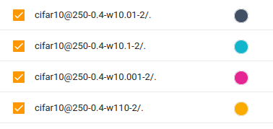
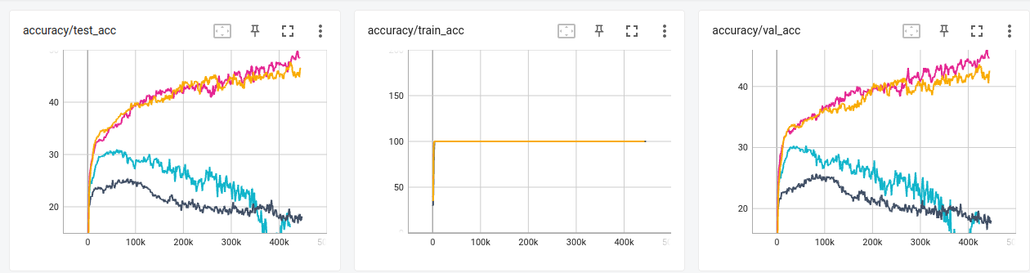
C) Changing Gradient
For this experiment, we modify the gradient of self-supervised projection head.

Slide 20
As also can be seen previously, ( ٖλ = 10) gives the best model performance, while
The performance trend goes in the order λ =10 > λ =0.001 > λ =0.01 > λ =0.1

Slide 21
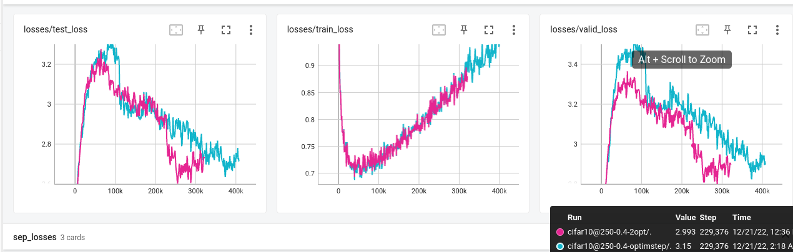
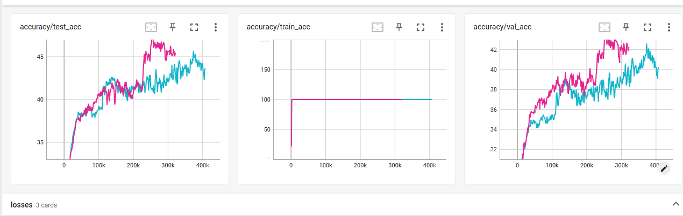
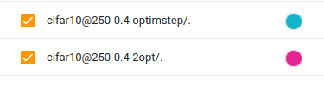
D) Optimiser update
For this experiment, we update the optimizers for both projection heads.
The following experiments have been done on a 250-label dataset with 40% added label noise

Slide 22
The model performs slightly better overall when both the optimizers get updated.Updating the optimizers of both heads can potentially improve the performance of the overall architecture because it allows each head to adapt to its specific task or subproblem more effectively. This can also be inferred from the loss and accuracy plots.

Slide 23
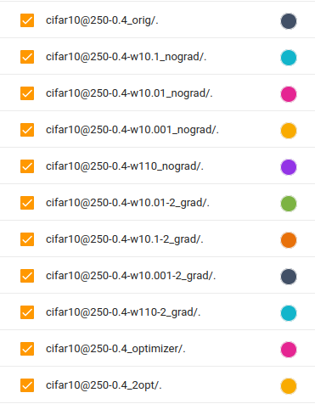
F) Ablation Analysis
For this experiment, we update the optimizers for both projection heads. The following experiments have been done on a 250-label dataset with 40% added label noise

Slide 24
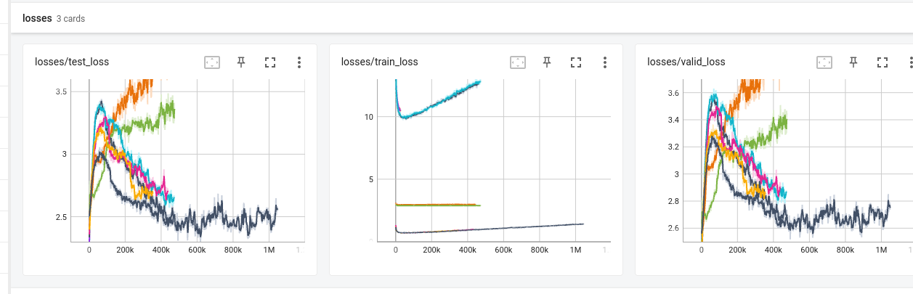
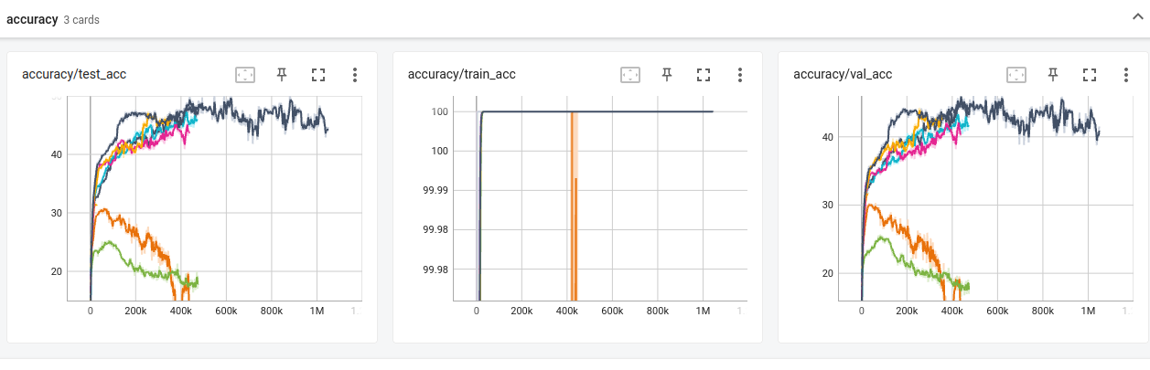

Slide 25
As we can see, changing the gradients of the model drastically effects model performance, while the other parameters, more or less, give close enough results.

Slide 26
THANK YOU
Contribution
Aman/Mann: Reproduction of results with added label noise, pseudocode and modifications
Abhigyan: Presentation, Analysis of result, pseudocode and modifications

